Slide 1
Proposal of New System Workflow
DEVELOPMENT OF AN INDIVIDUALIZED ENERGY CONSUMPTION MONITORING SYSTEM FOR SHARED HOUSES, APARTMENTS, & SMALL-SCALE BOARDING HOUSES
Subject: Adding the development of a support application for computing individual payment fee

Slide 2
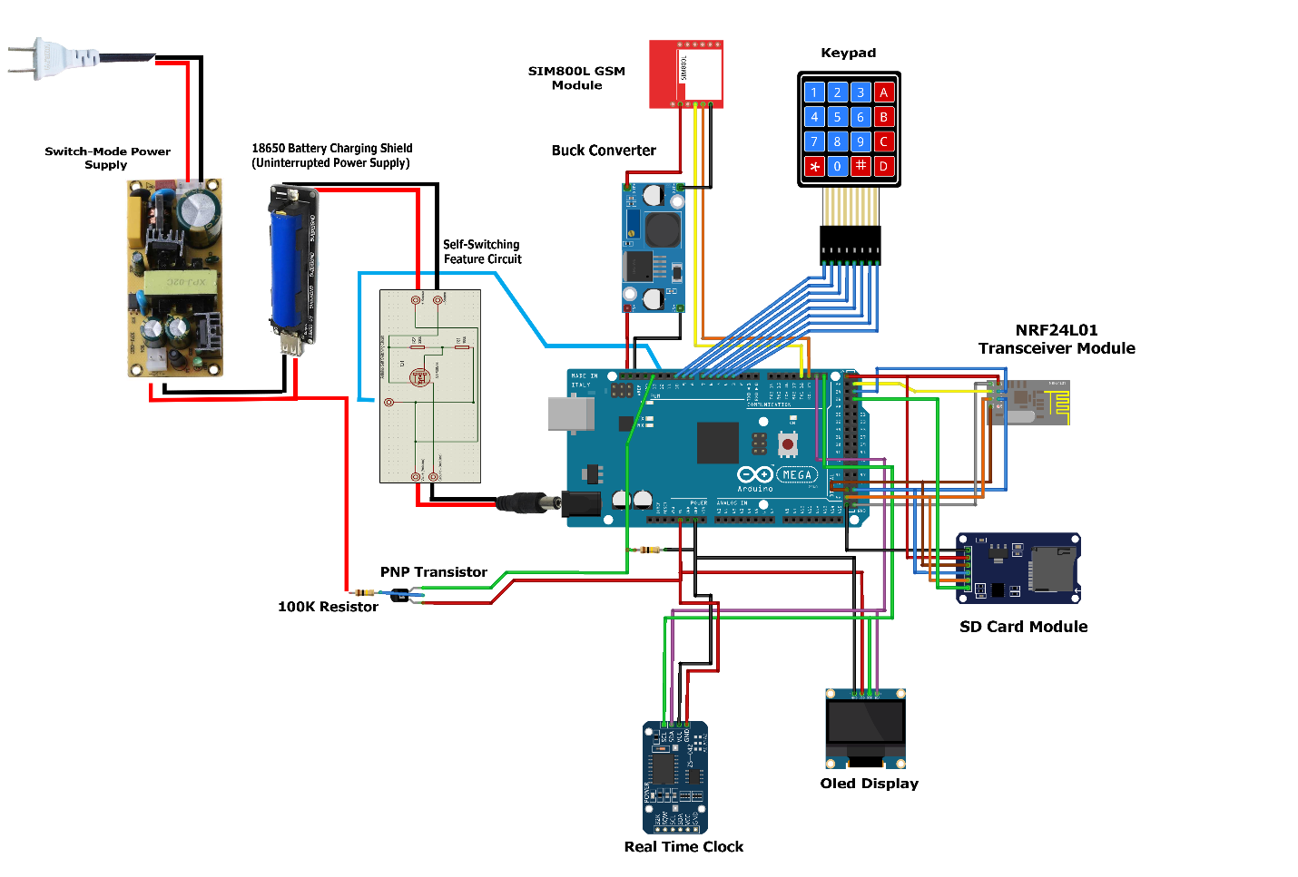
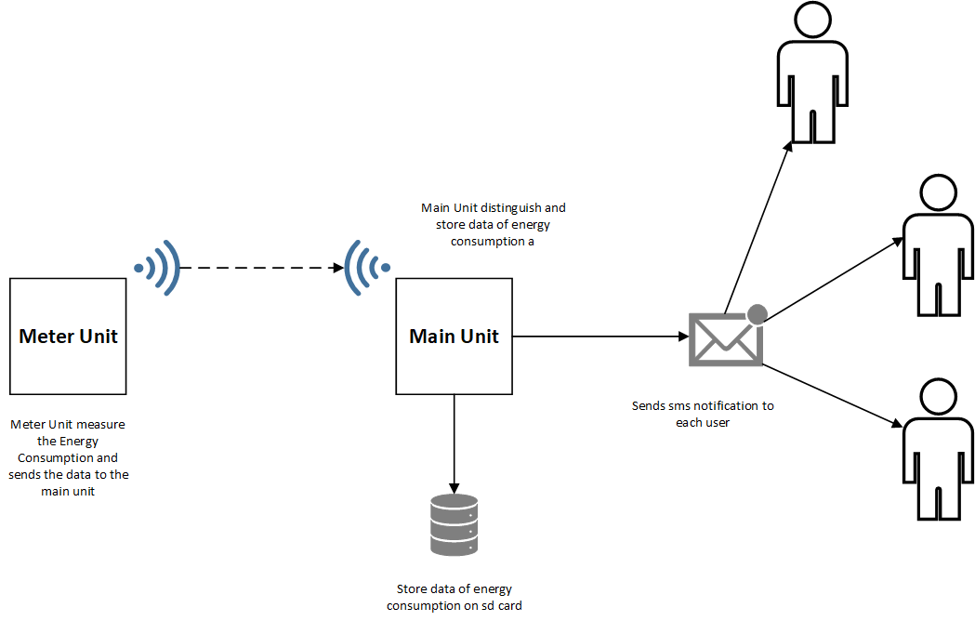
ORIGINAL WORKFLOW PRESENTED DURING PROPOSAL DEFENSE
Disadvantages:
Difficult to manage load on GSM module due to the fact that SMS is not free in our country; and so to send SMS requires load balance
Additionally the GSM module consumes more power during sending and receiving SMS and could lead to power problems in the system because the sd card module also consumes a pretty huge amount of current during read/write operation.

Slide 3
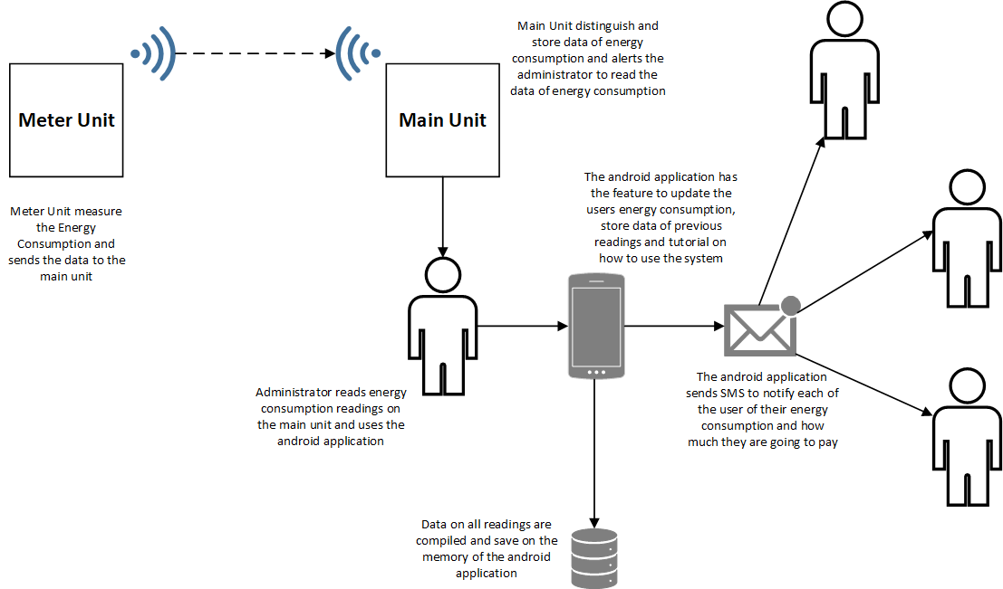
PROPOSED WORKFLOW
Advantages over the previous system workflow:
Sending SMS will be done in the android device of the administrator with the assistance of the android application
Only the android phone of the admin will require prepaid load
Data logging will be much more easier and convenient by being separated from the main unit and be easily retrieved from the android memory.
Development of an Android Application for the system

Slide 4
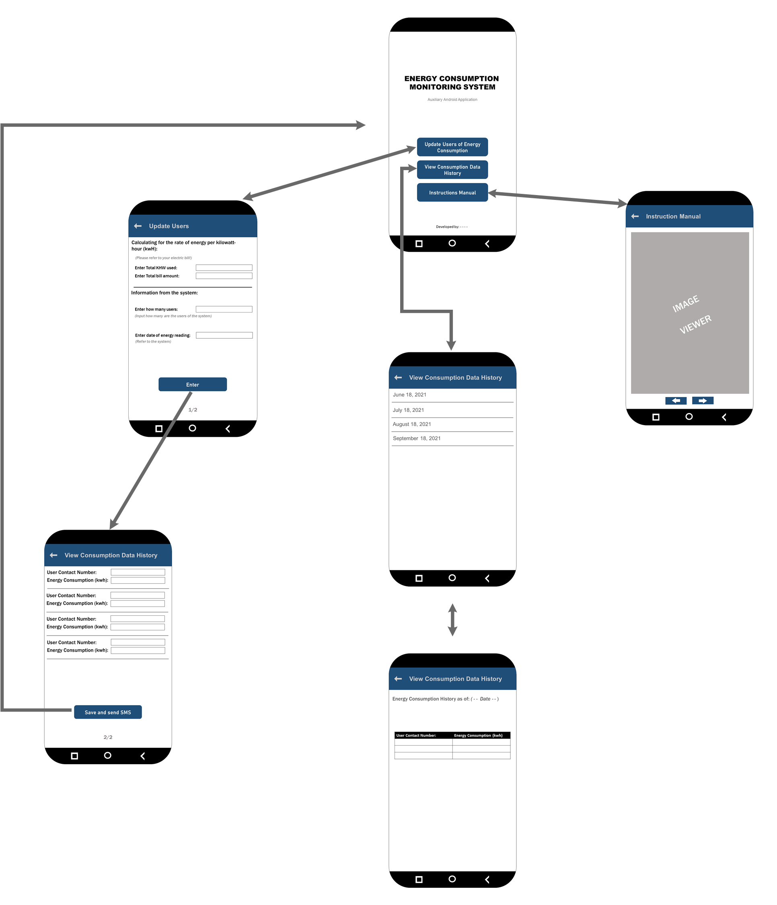
PROPOSED WORKFLOW
Development of an Android Application for the system
Android App User Experience and Layout Design

